Slide 1
Consumer Complaint Classification.
BY- L Abhishek Divecha
Rishabh Ranjan

Slide 2
Problem Statement
To classify the consumer complaint into various genres based on predefined categories, such as: Debt collection, Consumer Loan, Mortgage, Credit card, Credit reporting, Student loan, Bank account or service, Payday loan, Money transfers, Other financial service, Prepaid card etc.

Slide 3
DATA
Input data would be, a pre-existing data set with immense amount of consumer complaints categorised into respective categories, which will be used to train our system.
What is to be delivered?
It will return the category to which the new consumer complaint belongs to, along with the accuracy of the algorithm used here.

Slide 4
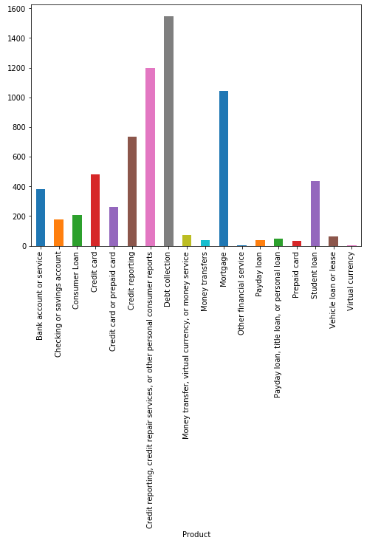
Analysing the Dataset

Slide 5
STEPS
We will start with PREPROCESSING and CLEANING of the data.
We build models based on the extracted features
We compare accuracies of our models
We use the model with highest accuracy to predict class of future Consumer Complaints.

Slide 6
PRE PROCESSING
Remove all the features that we aren't going use
Take Consumer Complaint text and remove all stopwords.
Then take unigrams and bigrams and rank them using tf-idf in each category

Slide 7
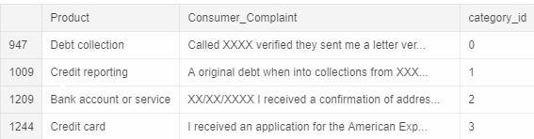
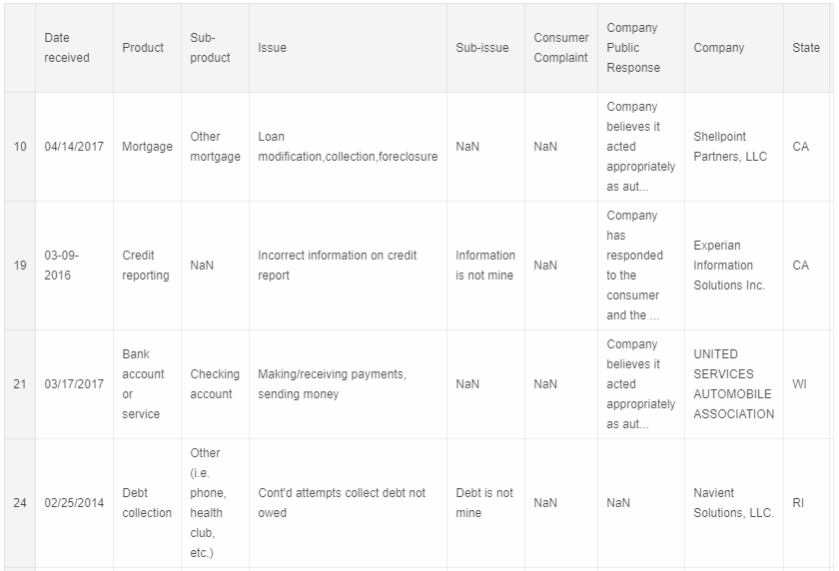
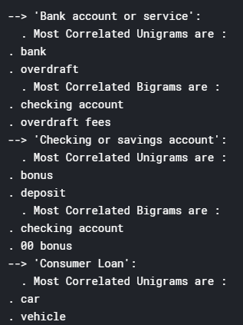
BEFORE
AFTER

Slide 8
TRAINING MODELS
Naive Bayes
Logistic Regression
Linear SVC
Random Forest

Slide 9
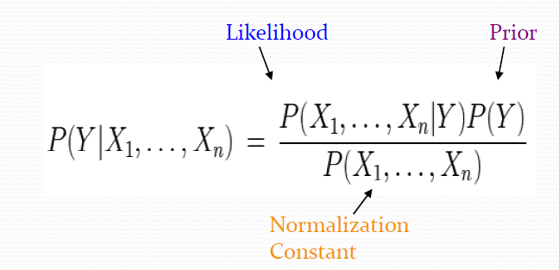
Multinomial Naive Bayes Classifier
It is based on bayes theorem, and bayes rule states that:
WEKA library can be used for machine learning in Bayes Classifier here.

Slide 10
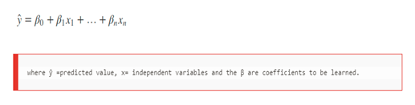
Logistic Regression
In its vanilla form, logistic regression is used to do binary classiﬁcation. Multiclass classiﬁcation with logistic regression can be done through the one vs rest scheme in which for each class a binary classiﬁcation problem of data belonging or not to that class is done.
The idea in logistic regression is to cast the problem in the form of a generalized linear regression model.

Slide 11
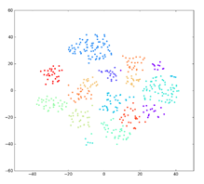
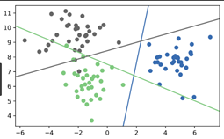
Linear SVC
Given labeled training data (supervised learning), the algorithm outputs an optimal hyperplane which categorizes new examples. In two dimensional space this hyperplane is a line dividing a plane in two parts where in each class lay in either side. We plot each data item as a point in N-dimensional space(where: N is number of features) with the value of each feature being the value of a particular coordinate. We have already converted our data into vectors: we can directly plot them.

Slide 12
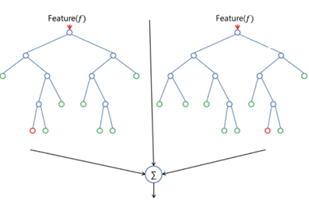
Random Forest
Random forest builds multiple decision trees and merges them together to get a more stable and accurate prediction.
Random Forest adds additional randomness to the model, while growing the trees. Instead of searching for the most important feature while splitting a node, it searches for the best feature among a random subset of features.

Slide 13
COMPARISONS : Using Cross Validation.
Steps for k-fold cross validation:
Step1: Split the data into k subsets.
Step2: Use each subset in turn for testing, the remainder for training.
2. Often the subsets are stratified before the cross validation is performed.
The error estimates are averaged to yield an overall error estimate.

Slide 14
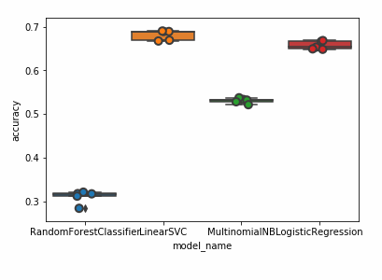
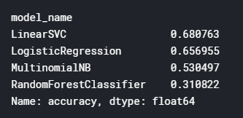
COMPARISONS
From the analysis of the various models used, we conclude that LINEAR SVC proved to be the best for our dataset. Random Forest has the least f1 measure and least accuracy. Although Naive Bayes uses feature independence assumption, it still gave us pretty good results.

Slide 15
Confusion Matrix
We take Linear SVC as our model from now on. And we output the confusion matrix.
This matrix allows the visualization of the performance of an algorithm.
It allows easy identification of confusion between classes e.g Business can be mislabeled as health or entertainment.
Given the very high accuracy of our models, large number of the predictions end up on the diagonal (on diagonal : predicted label = actual label), right where we want it to be.

Slide 16
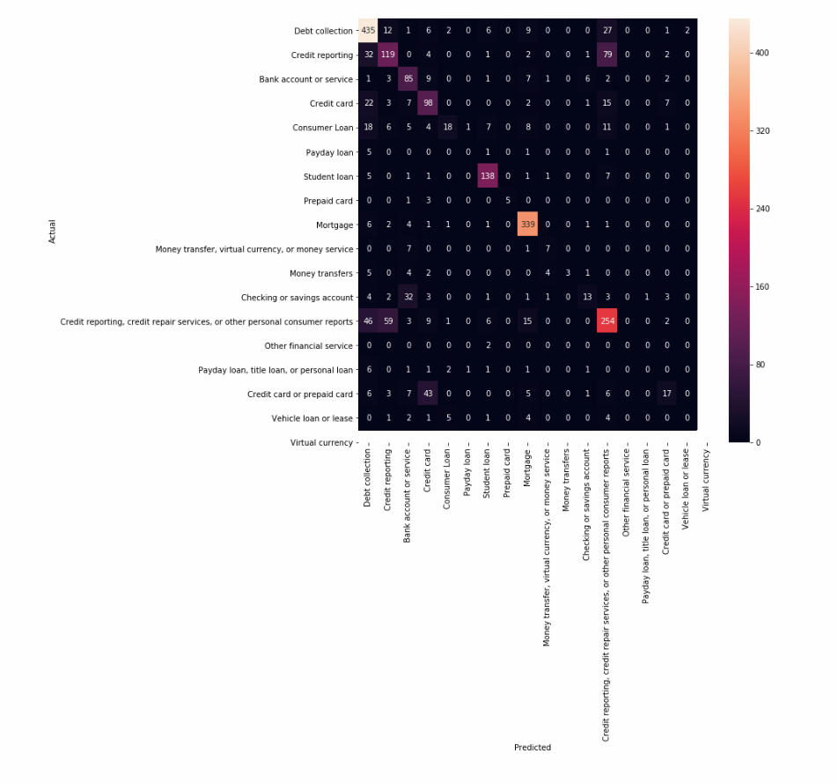

Slide 17

Predictions
Eg.
We can check some more on jupyter notebook.

Slide 18
Thank You !

